Slide 1

SRM INSTITUTE OF SCIENCE AND TECHNOLOGY
COLLEGE OF ENGINEERING AND TECHNOLOGY
DEPARTMENT OF NETWORKING AND COMMUNICATIONS
21CSC205P- DBMS
Cyber Cafe Management System
Student Reg No: RA2112703010020
Name: Subhashis Tripathy
Guide name and Designation: Dr. K. Kalaiselvi ,
Associate Professor , NWC.

Slide 2
Table of contents
Abstract
Introduction to project
Innovation of project
Purpose of project
Scope of project
Literature Survey
Limitations
Proposed system
Architecture Diagram
Module Description(algorithm)
Result and Discussion
Conclusion
Referneces

Slide 3
ABSTRACT
A cyber cafe management system is a software application designed to facilitate the smooth running of cyber cafes. This system manages the overall operation of the cyber cafe, including customer service, billing, inventory management, and security. The system ensures that customers have access to the services they need, while also ensuring that the business is profitable.
The software enables customers to log in and access the internet using a unique login ID and password. The system tracks the usage of the internet and other services provided, and customers are charged based on their usage. The software also includes a billing module that generates invoices, receipts, and reports.
The inventory management module tracks the inventory of hardware and software in the cyber cafe. The system alerts the staff when the inventory is low, enabling them to restock before running out of supplies. Additionally, the security module of the system ensures that the cyber cafe is safe from unauthorized access and cyber-attacks.

Slide 4
INTRODUCTION
In this project an attempt is made to design a computer system for the CYBER CAFÉ that makes the management of recording user details, internet usage and billing much easier. The objective of this software is to maintain the details of users, cabins and login history.
Through this system we provide facility of prepaid and postpaid accounts respectively for Account Users and Walkthrough Users. It has the features like adding, viewing, editing of user details, cabin details, recharge option for prepaid users, billing, tariff settings, etc.
The database is driven by My SQL thus providing portability. Anyone having an account with the system can have access to internet by logging into the client machine using a given username and password. Account users can login only if they have sufficient balance in the account. Otherwise they will have to recharge their account using the recharging facility at the administrator side.

Slide 5
INNOVATION OF THE PROJECT
The innovation of the project is to provide Security to the customer by securing the password and checking history by the administrator also it provides secure interface to the user and generate a report. Remote Access is there so that user access it from anywhere.

Slide 6
OBJECTIVE OF CYBER CAFE MANAGEMENT SYSTEM:
The objective and scope of my Project Cyber Cafe Management System is to record the details various activities of user and provide remote access to the customer. It will simplifies the task and reduce the paper work. During implementation every user will be given appropriate training to suit their specific needs.

Slide 7
SCOPE OF THE PROJECT
The system we propose has great scope in the current real time situation. The cyber crime monitoring system can be enhanced to an extent by implementing this system. Most of the firms and establishments are being computerized in order to ease the tasks to be performed. The internet cafés unfortunately are rarely computerized. We aim through this venture, a better reliable solution. In the primary stage of feasibility study itself we received an exquisite response and so we plan to go ahead with our project.

Slide 8
Literature Survey
SR.NO | TITTLE | AUTHORS | PUBLICATION AND YEARS | METHODOLOGY | PROS | CONCS
1. | Security and Software for Cybercafes | Alex Obuh | 2019 Delta State University, Abraka | The role of cybercafé management software in enhancing Internet security, limitations of cybercafé software, future trends, and future research direction. | Privacy The biggest concern for most PC users is privacy. Wi-Fi hotspots in most public areas are unsecured, which means that others could potentially access information on your computer. If you forget to log out of a public computer terminal, someone could access your email or other sensitive accounts. | High initial investment: Implementing a cyber cafe management system requires significant investment in hardware, software, and infrastructure. This can be a significant barrier for small business owners who may not have the financial resources to make such an investment.
2. | CYBER CAFE MANAGEMENT SYSTEM | Almer Matias | 2017 University Malaysia Pahang | It is argued that cybercafé management software has the capability of keeping a large client database with which it draws its strength for asset tracking, calculating client’s bonus on patronage, and in keeping an audit trail thus securing financial transactions. | Performance Internet cafes geared toward gaming have high-performance computers. Most PC games have much higher requirements than the average personal computer. If you play the game at an Internet cafe, you will enjoy the game at its full optimization without the burdensome cost of buying a special gaming PC. | Maintenance costs: Cyber cafe management systems require regular maintenance and updates to keep them running smoothly.

Slide 9
PROBLEM DEFINITION
The purpose of the project is to automate cyber cafes. The software must include provisions to keep user details and login history. It should help the café owners to retrieve user details when needed and internet usage in the system. It should be capable of allocating cabins automatically. It should help the café owner in calculating daily usage of the systems and income.

Slide 10
LIMITATIONS OF THE PROJECT
Limited scope: The project is limited to the management of a cybercafe, and may not address the needs of other types of businesses.
Cybercafe specific features: The system may have features that are specific to cybercafes and may not be useful in other settings.
Technical limitations: The project may be limited by the technology available for implementation, and may not be able to take advantage of the latest technological advances.
Security concerns: Cybercafes are often targeted by hackers and other cybercriminals, so the system must be designed with strong security measures to protect customer data.
Infrastructure limitations: The success of the project may depend on the availability of a reliable internet connection, which may be a challenge in some areas.
Cost: The development and implementation of a cybercafe management system can be expensive, and may not be feasible for smaller businesses.
Training requirements: The system may require specialized training for employees to use it effectively, which can be time-consuming and costly.
Maintenance and updates: The system may require regular maintenance and updates to keep it functioning properly, which can be a drain on resources.

Slide 11
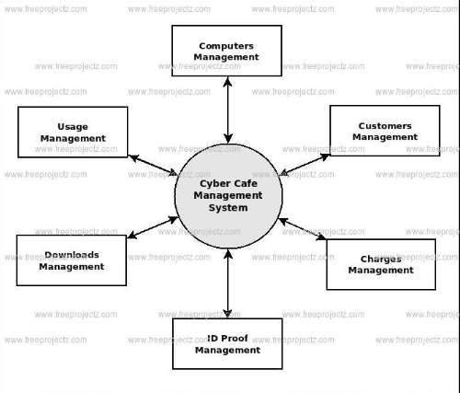
ARCHITECTURE DIAGRAM

Slide 12
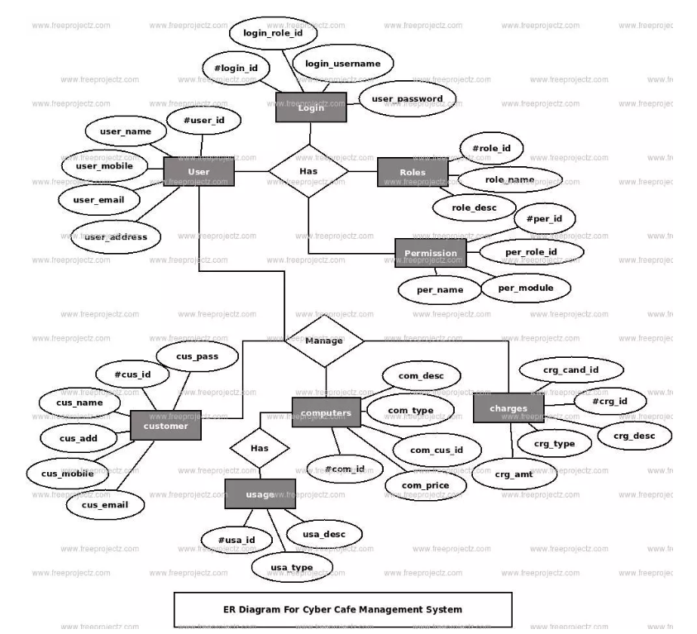
E-R diagram

Slide 13
ALGORITHM
1. Create the database with the defined schema. Set up any necessary relationships between tables (e.g. foreign keys) and constraints (e.g. check constraints, unique constraints).
2. Insert the initial data into the tables. For example, you might add records for the computers available for use in the cybercafe, customer records with contact information, employee records with their details, etc.
3. After logging in, customers should be presented with a screen that displays their login-logout history, as well as an option to mark pay there money for the current day.
4. When a customer’s marks their payment status, the system should record their ID, the current date, and their paying status (successful/unsuccessful).
5. The system should also be able to generate reports showing the login-logout history records of customers for a specific period, such as a week or a month.
6. Additionally, the system should allow administrators to add customers to the database, update existing records, and delete records if necessary.

Slide 14
7. The system should also provide security features such as password protection, and only authorized users should be able to access the system.
8. Finally, the system should be regularly backed up to ensure that data is not lost in case of system failure or other issues

Slide 15
MODULES
User Management: This module is used to manage user accounts and access. It includes features like user registration, login, logout, and password reset. It also allows the owner to set user permissions, access levels, and usage limits.
Computer Management: This module is used to manage the computers in the cybercafe. It includes features like adding and removing computers, tracking computer usage, and managing computer reservations.
Time Management: This module is used to manage the usage time of the computers. It includes features like setting usage rates, monitoring usage time, and generating reports on computer usage.
Billing and Payment: This module is used to manage billing and payment transactions. It includes features like creating invoices, tracking payments, and generating reports on financial transactions.
Inventory Management: This module is used to manage inventory items like computer hardware, software, and peripherals. It includes features like adding and removing inventory items, tracking inventory levels, and generating reports on inventory usage.
Security Management: This module is used to manage the security of the cybercafe. It includes features like setting up firewalls, antivirus software, and other security measures to protect the computers and user data.

Slide 16
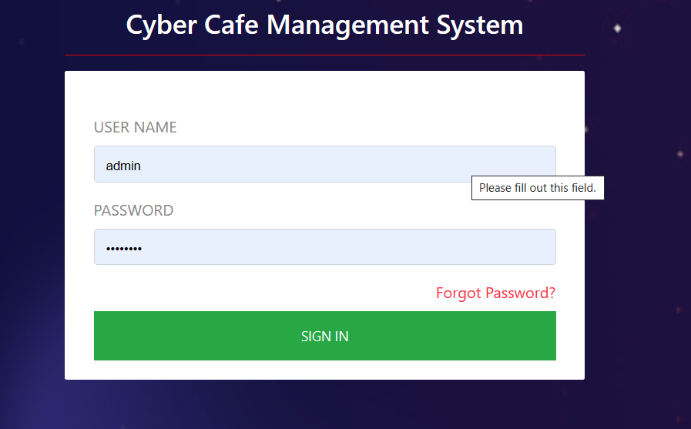
RESULT AND DISCUSSION
USER LOGIN MODULE: - This module is used to manage user accounts and access. It includes features like user registration, login, logout, and password reset. It also allows the owner to set user permissions, access levels, and usage limits.

Slide 17
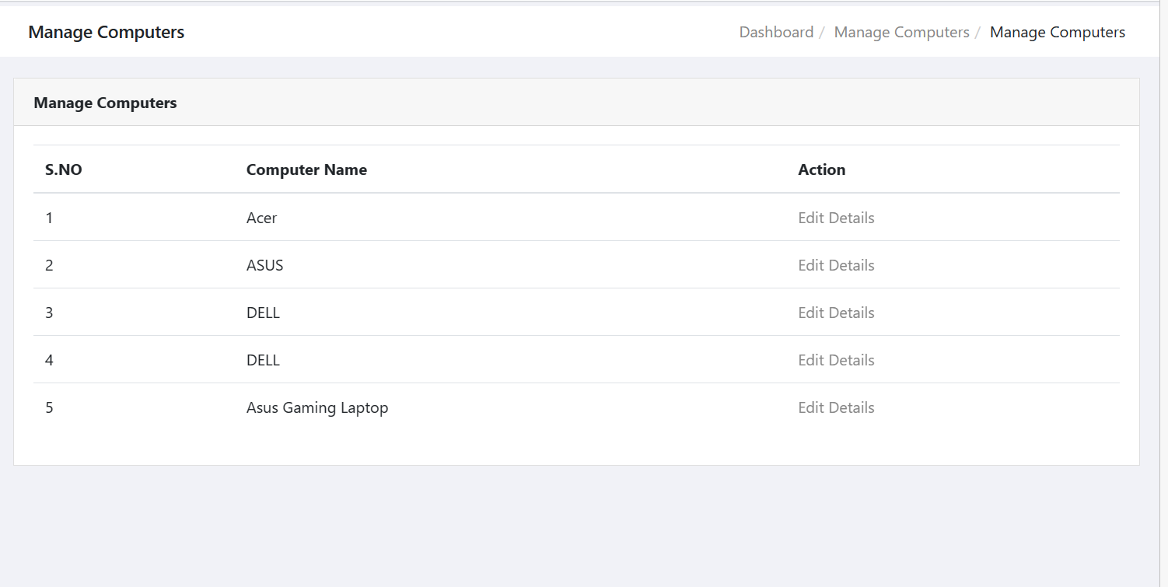
2. COMPUTER MANAGEMENT: - This module is used to manage the computers in the cybercafe. It includes features like adding and removing computers, tracking computer usage, and managing computer reservations.

Slide 18
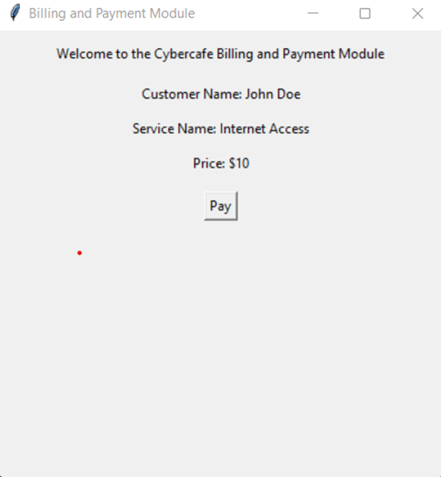
3. Billing and Payment: This module is used to manage billing and payment transactions. It includes features like creating invoices, tracking payments, and generating reports on financial transactions.

Slide 19
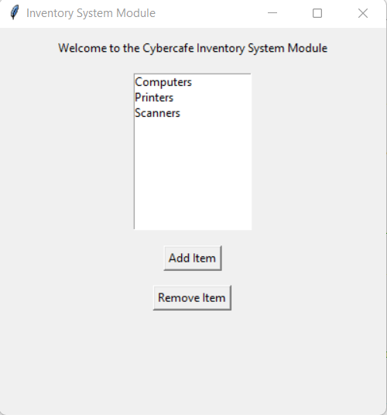
4. INVENTORY MANAGEMENT: This module is used to manage inventory items like computer hardware, software, and peripherals. It includes features like adding and removing inventory items, tracking inventory levels, and generating reports on inventory usage.

Slide 20
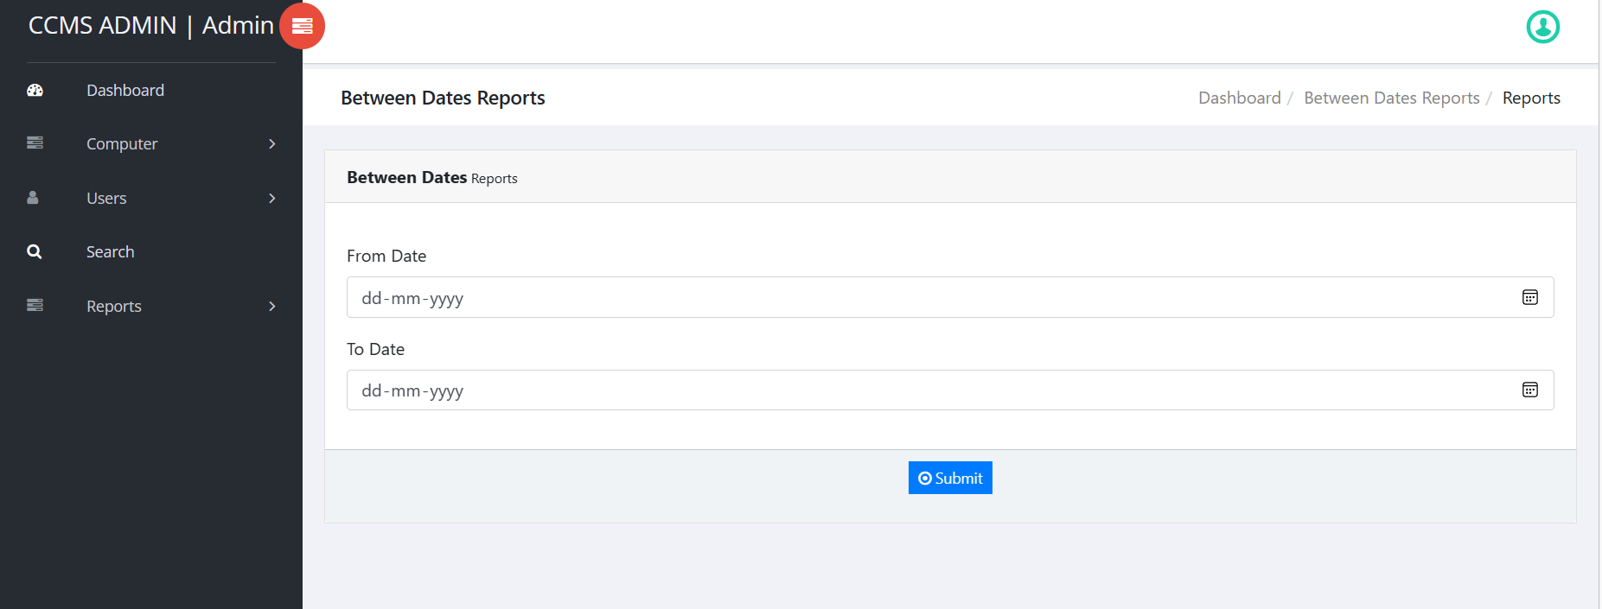
5. SECURITY AND REPORT MANAGEMENT: This module is used to manage the security of the cybercafe. It includes features like setting up report by using between dates report the administrator easily can see this, and other security measures to protect the computers and user data.

Slide 21
CONCULSION OF THE PROJECT
In conclusion, a cybercafe management system is an essential tool for managing and operating a cybercafe efficiently. It provides several modules, including user management, computer management, time management, billing and payment, inventory management, security management, and reporting and analytics.
These modules work together to streamline operations, improve customer service, and increase profitability.
With a cybercafe management system, owners can easily track computer usage, manage inventory, and generate reports on financial transactions, usage statistics, and other important metrics.
They can also ensure that their cybercafe is secure and protected from cyber threats.

Slide 22
REFERNCES
[1] Olatunji O. A., & Adeniji A. A, et al. “Design and implementation of a cybercafe management system” 2015 International Journal of Computer Science and Mobile Computing, 2015, 137-144.
[2] Olaniyan, R. O.Ayo, et al. “Design and implementation of cybercafe management system”. International Journal of Computer Applications Technology and Research,2015, pp. 273-278.
[3] Ahmed, S. S., & Wasiq, M. “A review of cybercafe management systems”. International Journal of Emerging Technology and Advanced Engineering, 2016, pp. 277-281.
[4] Santhoshini, G. “Cyber cafe management system”. International Journal of Science, Engineering and Technology Research, 2017, pp.436-442.
[5] Kumar, S. “Development of cybercafe management system”. International Journal of Advance Research in Computer Science and Management Studies, 2018, pp. 57-62
[6] Abhishek Kumar, Ashish Kumar, & Mukesh Kumar. “Cybercafe management system using IoT”. International Journal of Innovative Technology and Exploring Engineering, 8(8S),2019, pp. 297-300.

Slide 23
[7] Chinonso Eke & Chukwuemeka Ikwu. “A comparative analysis of cybercafe management systems”. International Journal of Advanced Research in Computer Science and Software Engineering, 2020, pp. 105-113.
[8] R. K. Sharma,K. Singh, et al. Cybercafe management system: An effective tool for cybercafe owners. International Journal of Computer Science and Information Technologies, 2020, pp. 223-228
[9] Amatya, S. “Cybercafe management system using ASP.NET MVC”. International Journal of Scientific Research in Computer Science and Engineering, 2020, pp. 57-62.
[10] B. Y. Omole, A. S. Sodiya, O. A. Daramola, et al. “Design and implementation of a cybercafe management system using PHP and MySQL”. International Journal of Computer Applications,2021, pp. 32-39.

